Slide 1

Big Data Visual Analytics (CS 661)
Instructor: Soumya Dutta
Department of Computer Science and Engineering
Indian Institute of Technology Kanpur (IITK)
email: soumyad@cse.iitk.ac.in

Slide 2
Logistics

Slide 3

Course Staff
Instructor:
Soumya Dutta (soumyad@cse.iitk.ac.in)
https://soumyadutta-cse.github.io/
TAs:
TA information will be provided to you soon
Contact your assigned TA for grading help
We will use HelloIITK for this course
https://hello.iitk.ac.in/manage/cs661sem22324/course_home

Slide 4
Class Timings
Monday & Wednesday
Time: 2:00pm – 3:15pm
Location: Rajeev Motwani Building, Room: 101 (RM - 101)
Office hours: Monday 4pm-5pm or by appointment

Slide 5
Course Topics
Index | Module | Topics Covered
1 | Fundamentals of Data Visualization | Introduction to Visualization and Visual Analytics
 |  | Foundations of Data Visualization, Visual Abstractions, Visual Variables, Various types of Data
2 | Scientific Visualization (SciVis) | Introduction, Big Data Characteristics, Data Reduction, Various Data Models; Visualization Pipeline.
 |  | Scientific Visualization Software: VTK and ParaView
 |  | Linear Interpolation; Isosurface Algorithm; Volume Rendering Algorithm
3 | Information Visualization (InfoVis) | Fundamentals of Information Visualization, Visual Analytics, Software for Information Visualization
 |  | High Dimensional Data Visualization Techniques
4 | Big Data Visualization Techniques | Statistical Data Modeling and Visualization
 |  | Information Theory Techniques for Visualization
 |  | Time-varying Data, Ensemble Data and Uncertainty Visualization
5 | ML/DL for Data Analysis and Visualization | ML/DL for Visualization and Visual Analytics
 |  | Applications of ML/DL to Big Data Visualization, Data Modeling, Data Understanding
 |  | Visual Analytics, Explainability and Interpretability of ML/DL Models
6 | Advanced Topics | Extreme-scale Data Analytics, Exascale Computing, Parallel and High-performance Visualization
 |  | In Situ Analysis & Visualization and Future Paradigm

Slide 6
Grading/Evaluation Scheme
Category | Split
Quiz | 15%
Programming Assignments | 30%
Mid Sem | 25%
Final Sem Project | 30%
Assignments: Group of 2
Final semester project: Group of 7/8 (will be finalized later)

Slide 7
Noteworthy Points
We might add new, drop existing, or reorder topics depending on the progress and class feedback. Things may be changed by mutual consent after discussion in class.
Lectures in the class are the best resources.
Grading will be relative.
If required, extra classes will also be conducted in weekends.

Slide 8
Policies
You are expected to be on time for the lectures.
You are expected to submit your assignments in time.
There is a 10% penalty each day after the submission deadline for up to 20% (2 late days). After that, you get zero.
If you are unwell, please follow the standard IITK procedure.

Slide 9
Academic Honesty
Please DON’T CHEAT or Plagiarize!!
Students caught cheating or plagiarizing will automatically fail the course and will be reported to the institute.
You are expected to cite all sources in your reports including AI tools.
Your assignments should be your own original work.
IITK CSE Anti-cheating policy: https://www.cse.iitk.ac.in/pages/AntiCheatingPolicy.html
The List of Things I Never Want To Hear Again (by Tamara Munzner)
https://www.cs.ubc.ca/~tmm/courses/cheat.html

Slide 10


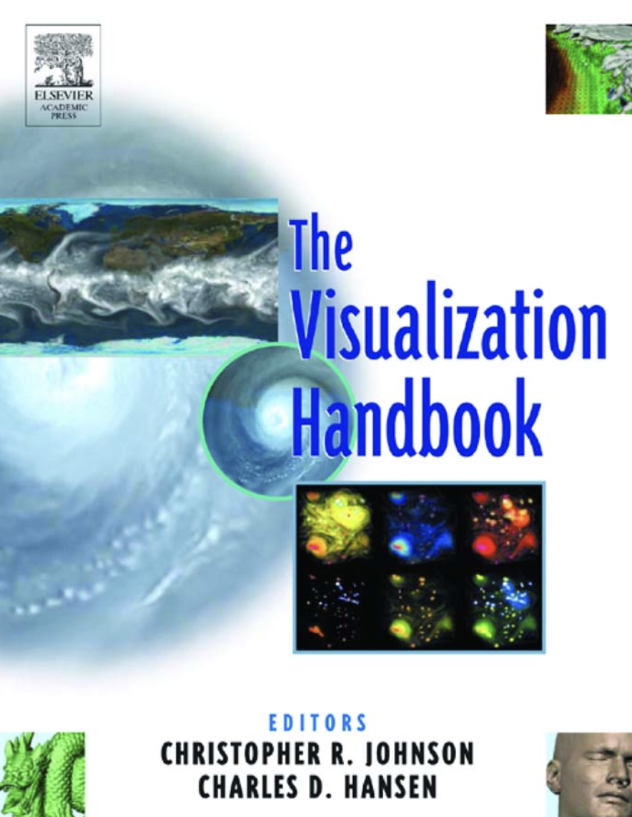
Resources
Data Visualization: Principles and Practice by Alexandru C. Telea, CRC Press
Visualization Analysis and Design by Tamara Munzner, A K Peters Visualization Series, CRC Press
The Visualization Handbook edited by Charles D. Hansen and Chris R. Johnson
Research papers and other study materials provided during the class to cover selected topics

Slide 11

Visualization is Cool! Applications in Science
https://www.youtube.com/watch?v=etUWNf2ZZpg

Slide 12
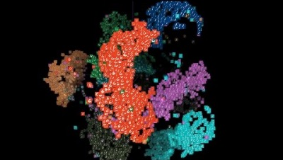
Visualization is Cool! Applications in ML
https://www.youtube.com/watch?v=wvsE8jm1GzE&list=RDQMjKx69KjeL5I&index=4

Slide 13
Course Overview: What Are You Going to Learn?

Slide 14
Overview
Data

Slide 15
Overview
Data
Visualization

Slide 16
Overview
Data
Visualization
Analytics

Slide 17
Data
Various types of data
How to handle such data?
How to process and analyze such data?
How to Visualize such data?
How to perform interactive analytics with data?
How to find features/patterns from data?
How to deal with big data?
How to intelligently summarize large data?

Slide 18
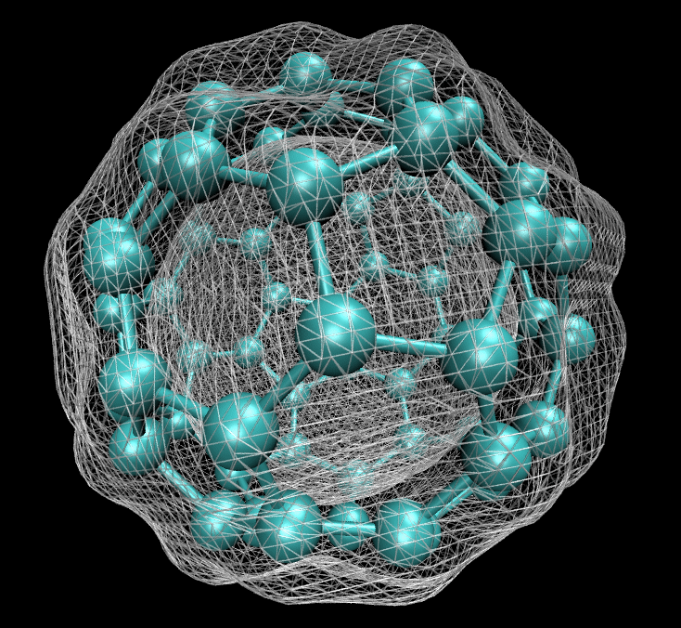
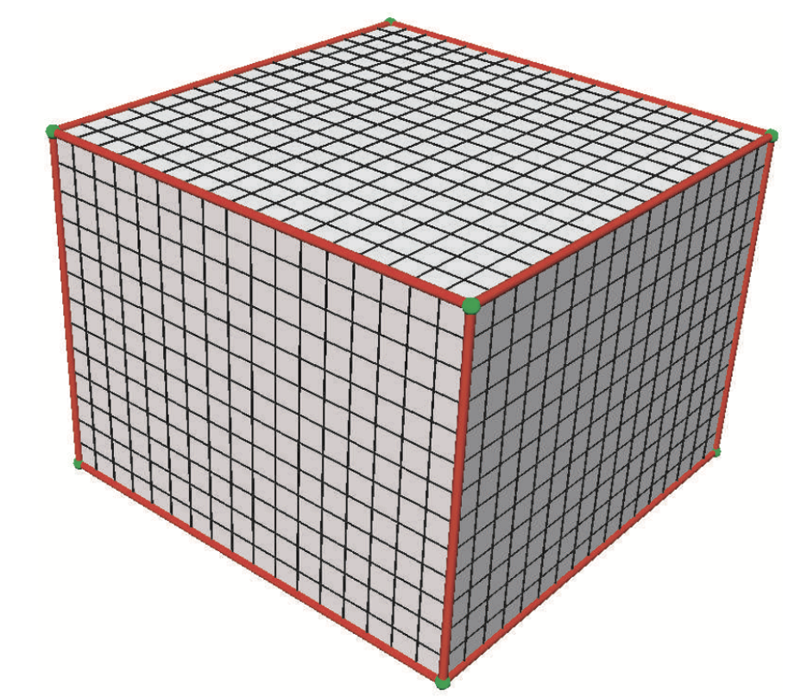
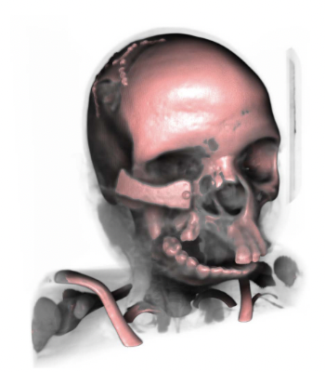
From Data to Visualization
Visualization
in Physical Science
Visualization
in Medical Science
Source: Google

Slide 19
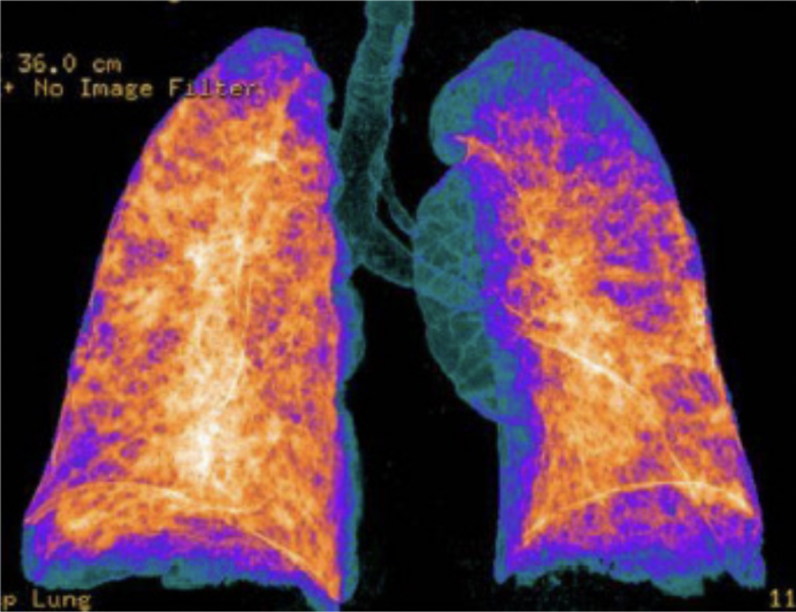
From Data to Visualization
Visualization of Covid 19 Data
Source: Google

Slide 20
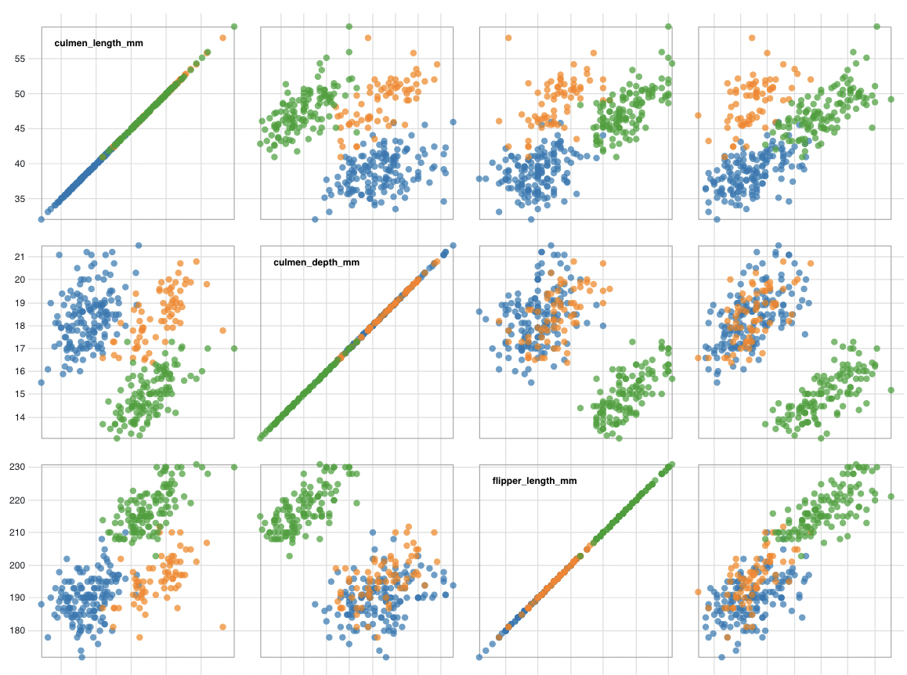
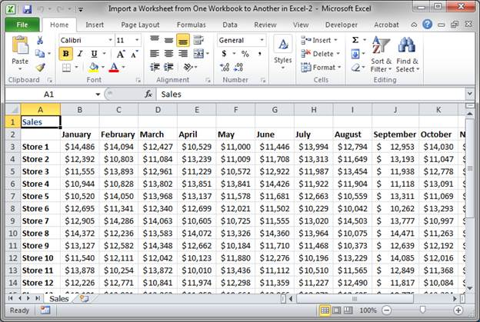
From Data to Visualization
Visualization of correlation
Source: Google

Slide 21
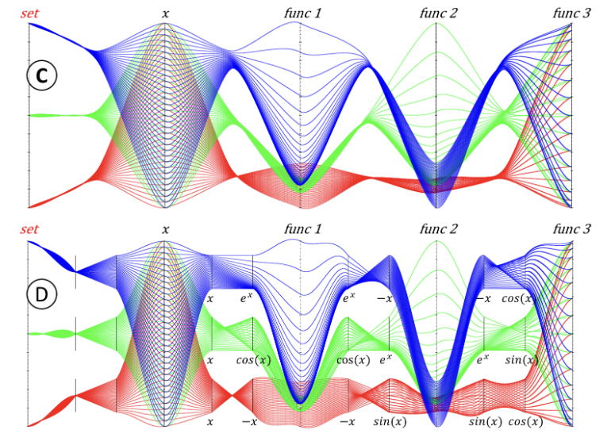
From Data to Visualization
Visualization for finding relationships in variables
Source: Google

Slide 22
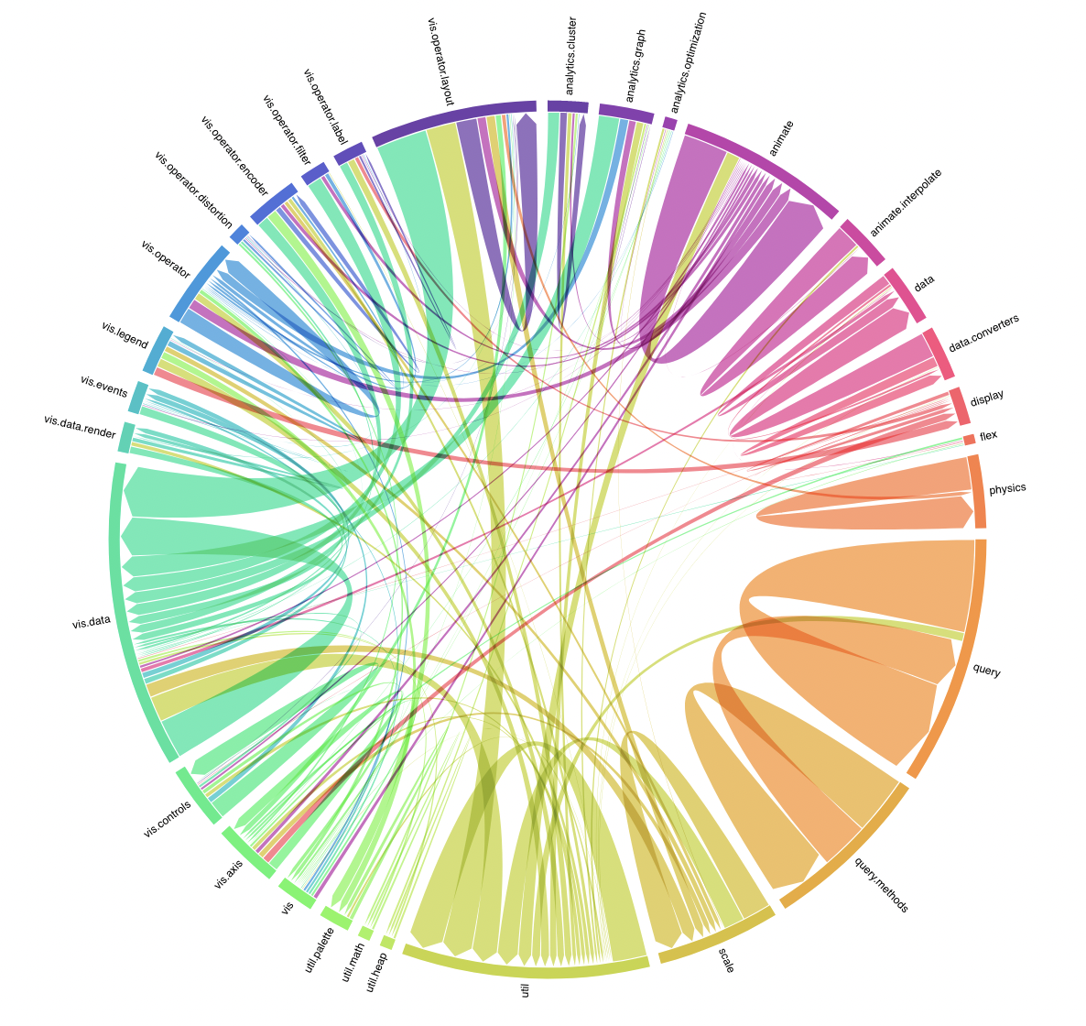
From Data to Visualization
Visualization for finding connections in variables
Source: Google

Slide 23
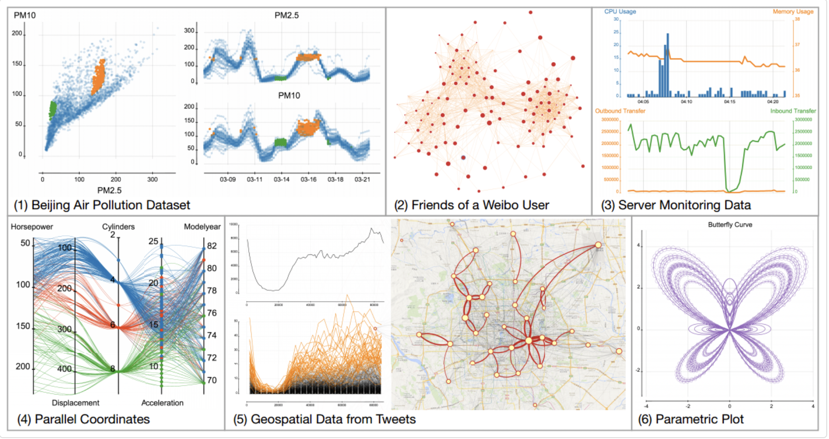
High Dimensional Data to Visualization Space
Visualizing High Dimensional Data
http://vis.pku.edu.cn/hdvis/en/projects/interactiveCustomization.html

Slide 24
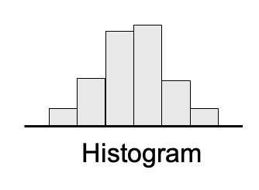
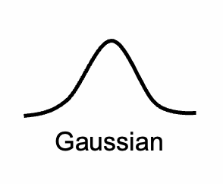
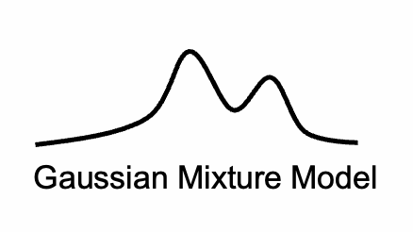
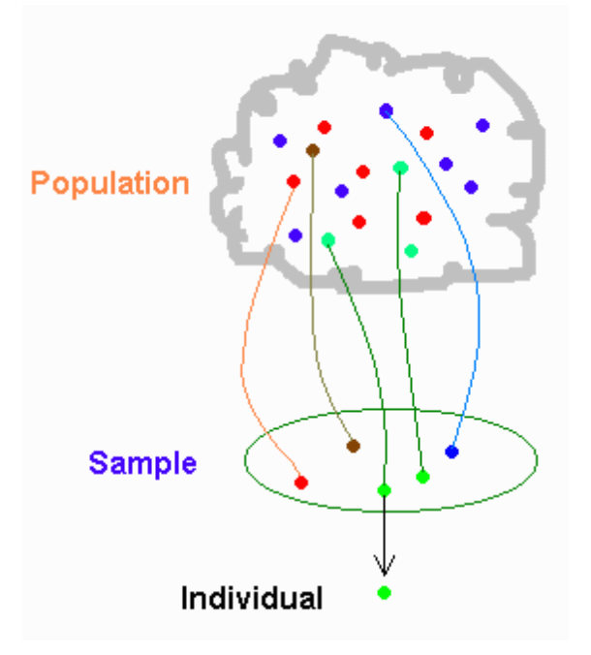
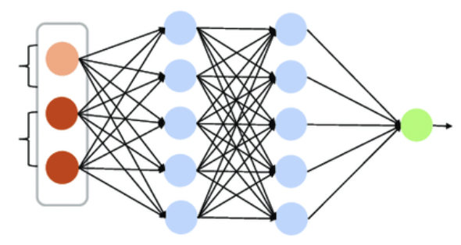
From Data to Transformed Representation
Sampling
ML Model

Slide 25
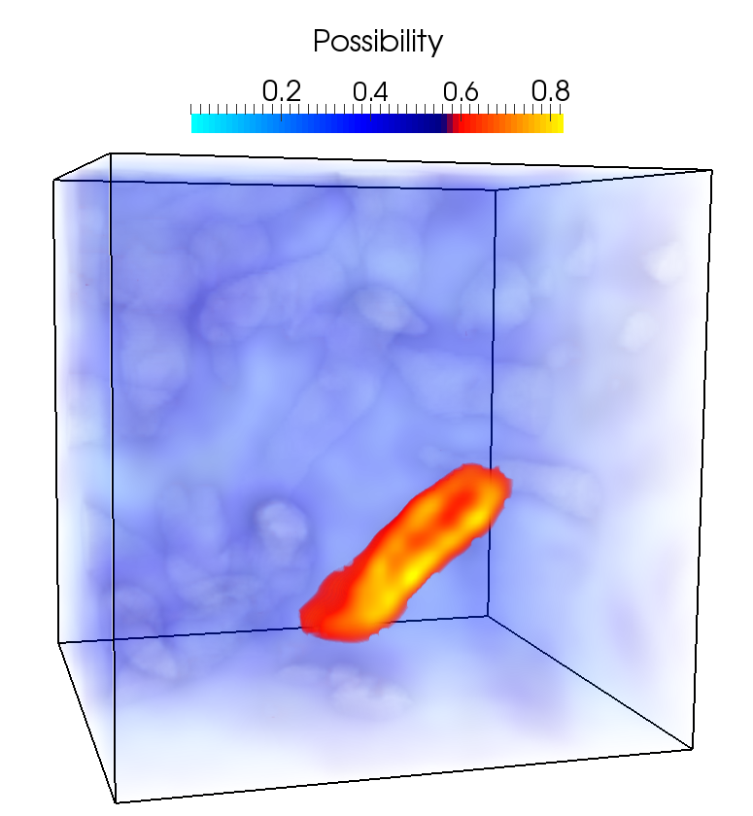
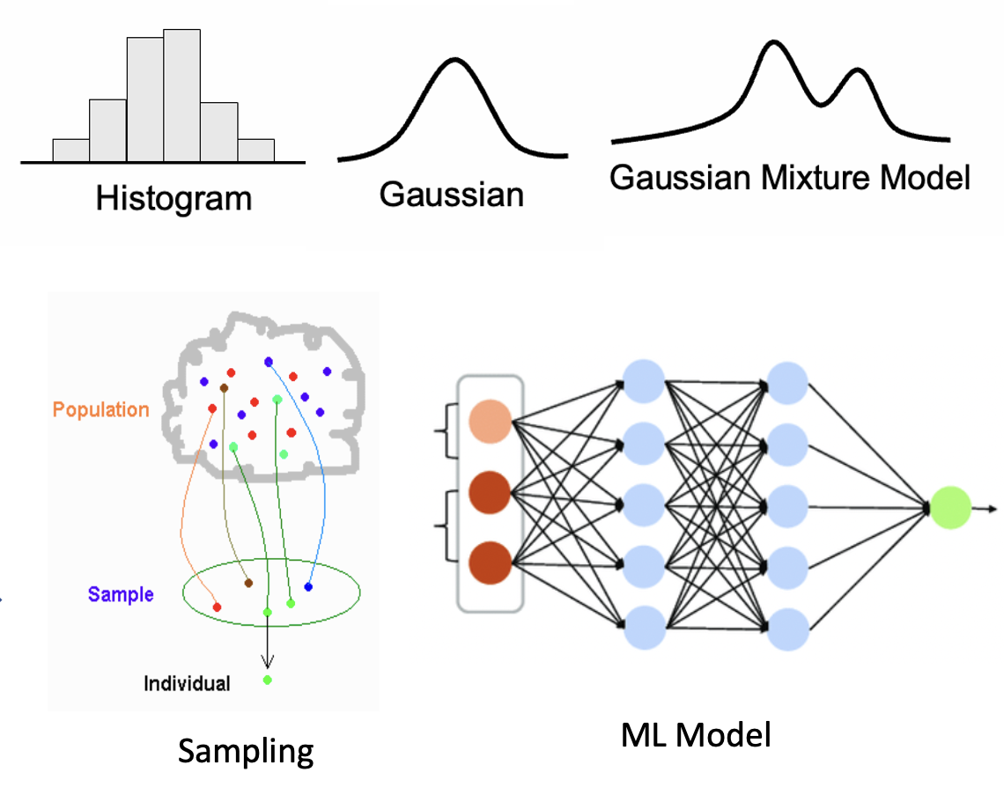
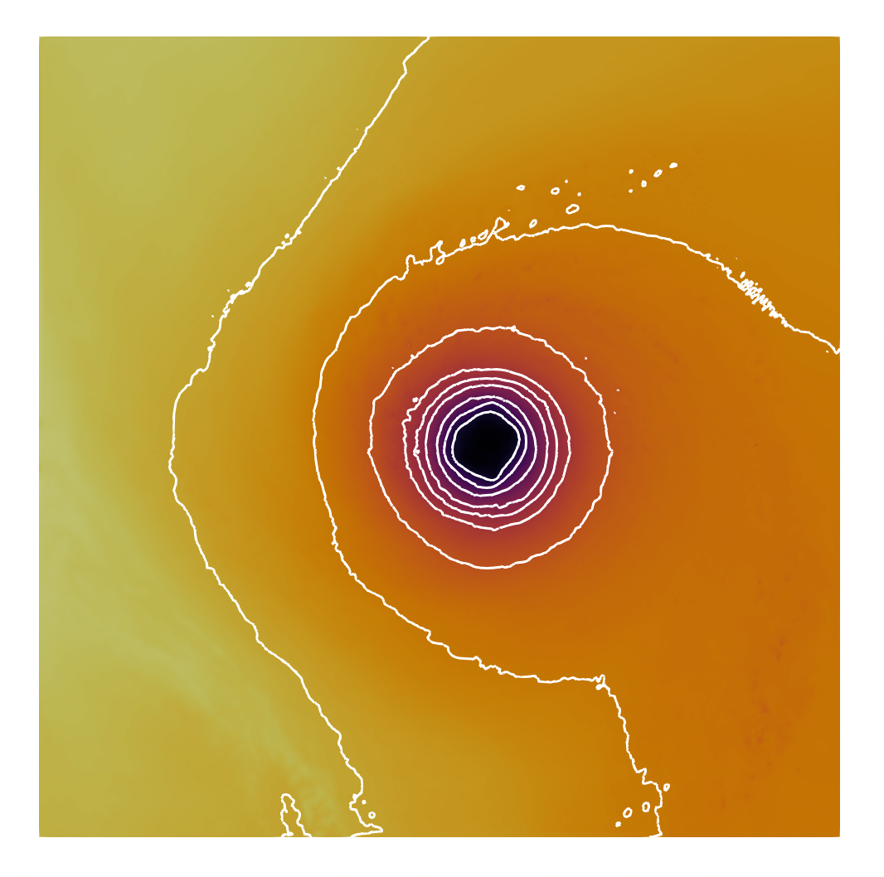
From Transformed Data to Visualization
Source: Google

Slide 26
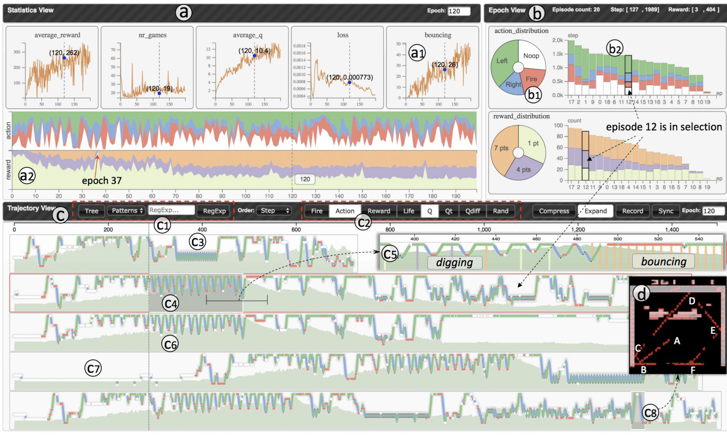
Visualization for Machine/Deep Learning
Visualizing How a DL Model Works
Source: Google

Slide 27
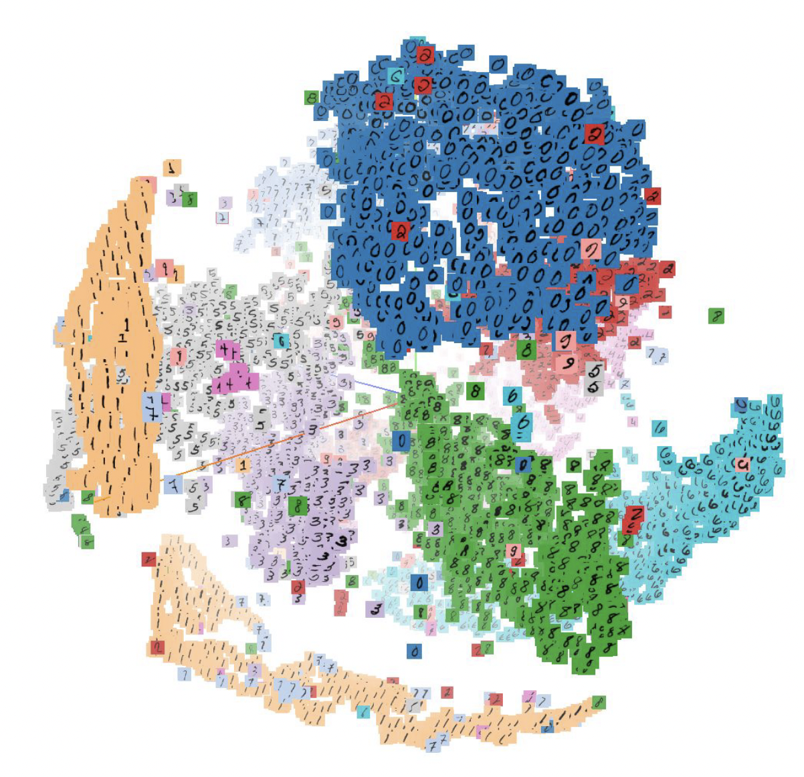
Visualization for Machine/Deep Learning
Visualizing Results of a ML Model Prediction
Source: Google

Slide 28
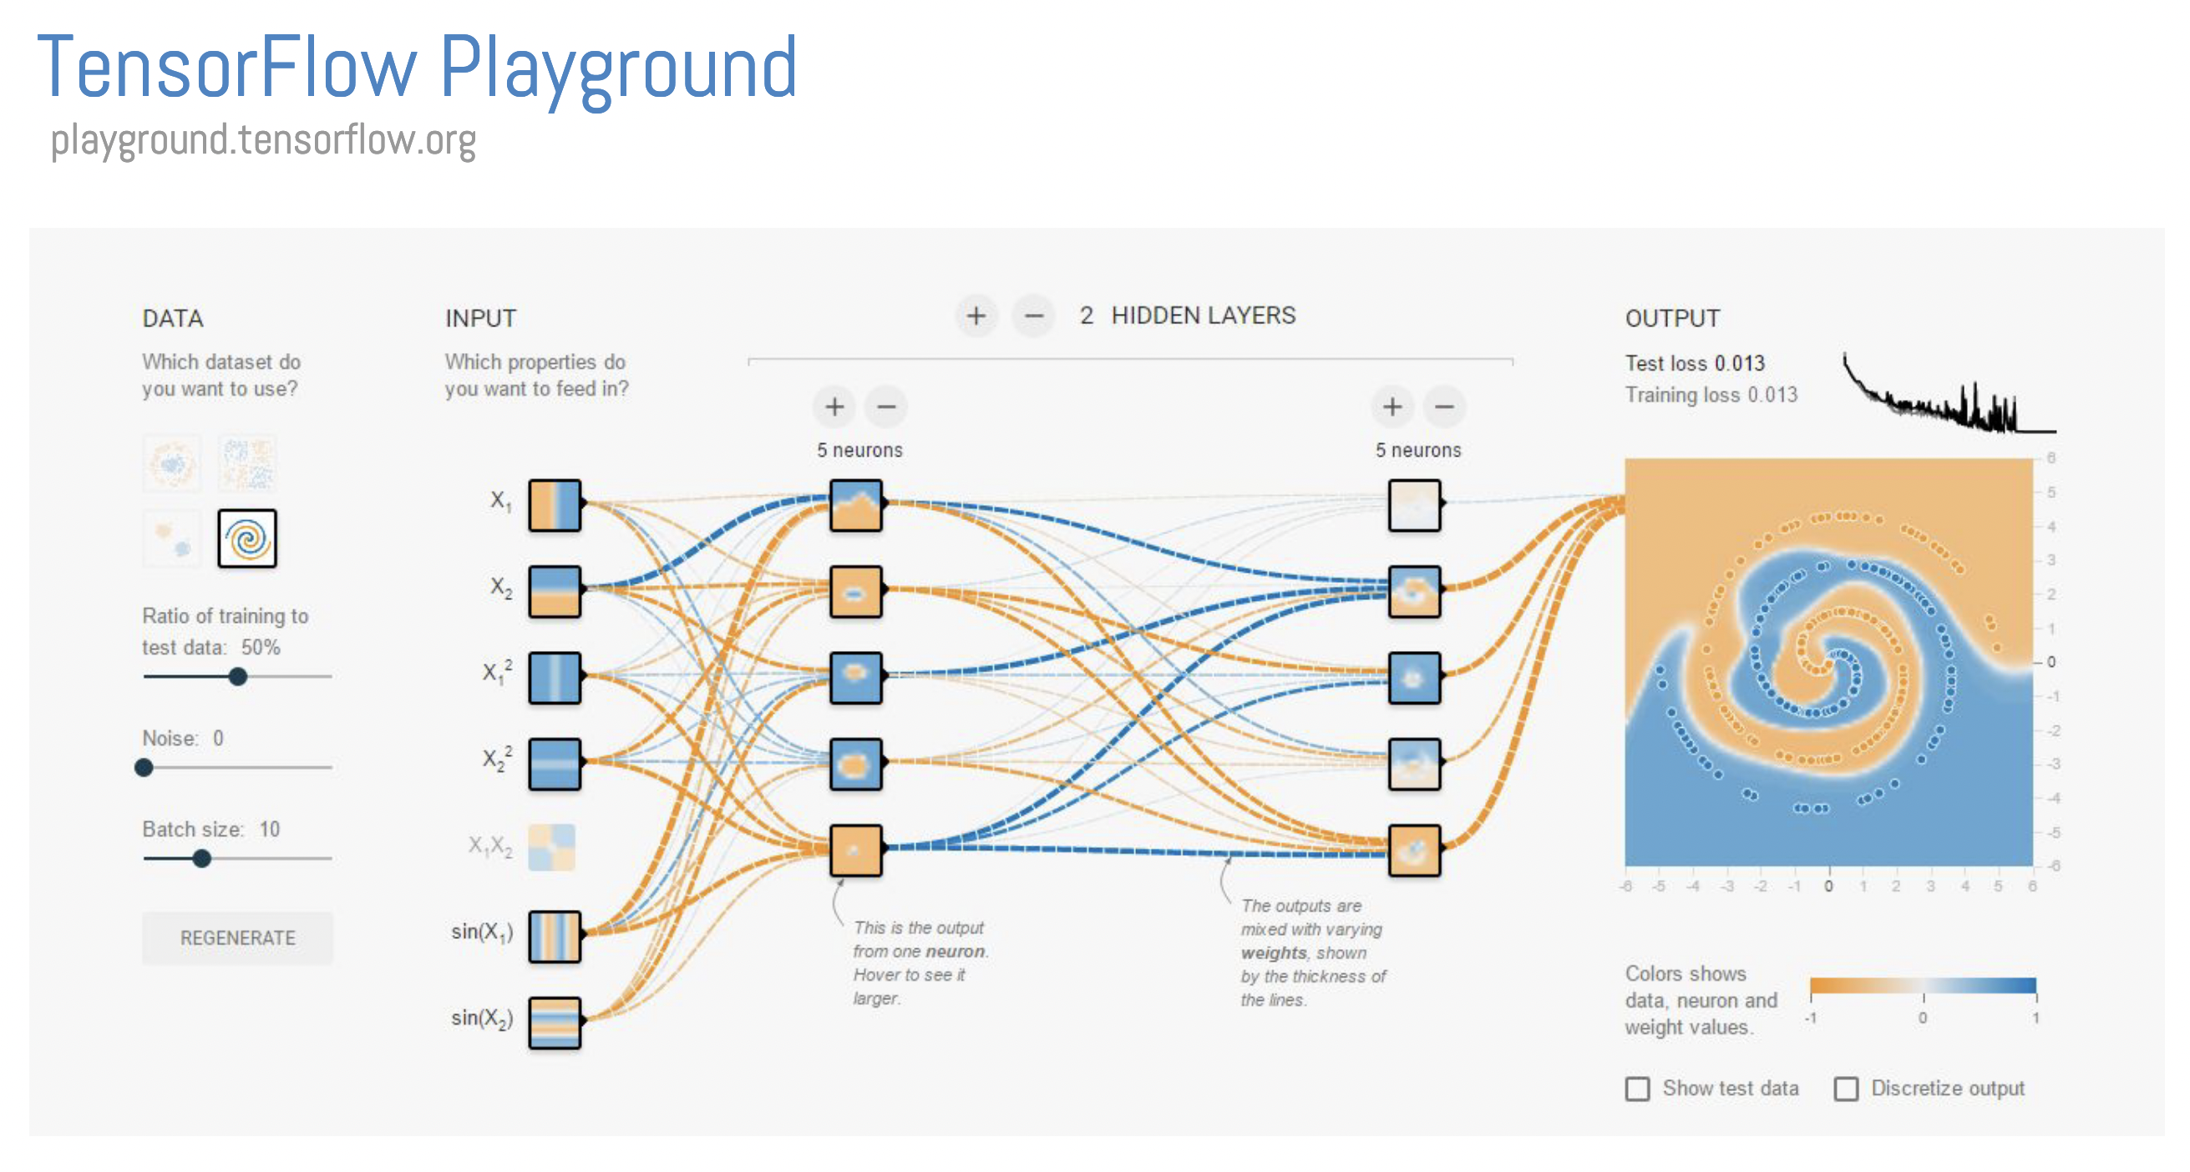
Visualization for Machine/Deep Learning
Source: Google

Slide 29
Visualization for Machine/Deep Learning
CNNVis
http://shixialiu.com/publications/cnnvis/demo/
CNN Explainer
https://poloclub.github.io/cnn-explainer/
Understanding DNN:
https://distill.pub/2020/grand-tour/
GAN lab
https://poloclub.github.io/ganlab/

Slide 30

Visualization and Data Analysis at Exascale
In Situ Data Analysis and Visualization
High Performance Visualization
Frontier: World’s First Exascale Supercomputer (https://www.olcf.ornl.gov/frontier/)
Exascale: 10¹⁸ IEEE 754 Double Precision (64-bit) operations (multiplications and/or additions) per second (exaFLOPS)
Source: Google

Slide 31
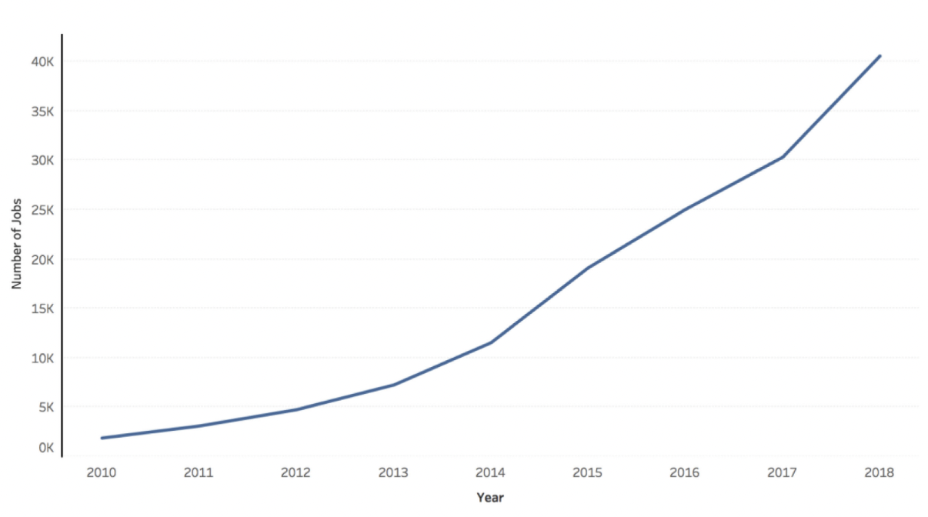
Why Should You Learn Visualization and Visual Analytics?
The growth of jobs mentioning “data visualization” as a skill from 2010 has steadily increased from only 1,888 jobs in 2010 to 30,327 jobs in 2017 (16X growth)
Teaching Data Visualization as a Skill, Ryan et al, IEEE CG&A 2019

Slide 32
Modern Data Scientist
Math/Stats
Machine learning, Data Analytics
Statistical modeling
Programming
Computer Science fundamentals
Strong programming skills
Visualization and Communication
Domain knowledge / soft skills
Optimization
Linear Algebra, Probability
Bayesian Inferencing
Knowledge in Python, JavaScript, C/C++ programming
Knowledge in Databases
Knowledge in Vision, Visual Computing, and Perception
Plotting patterns from data visually
Fundamental data visualization algorithms
Communicating results effectively
Enabling interactive data analytics and HCI
Understating application domain problems
Effective communication skills

Slide 33
What is Expected From You?
Basic knowledge of Linear Algebra, Probability, and Statistics
Strong programming background (primarily in Python)
Interest and Motivation to learn new topics (sometimes on your own!)
Creativity and Imagination
If you do not have the above skills or unsure, talk to me!
Goal of the Course: Give you a comprehensive view of the Big Data Visualization and Analysis Research Field
You can conduct further research in these topics (talk to me!)
You can use the learned skills in industry/academia

Slide 34
Introduction

Slide 35
Acknowledgements
Some of the following slides are adapted from the excellent course materials made available by:
Prof. Klaus Mueller (State University of New York at Stony Brook)
Prof. Tamara Munzner (University of British Columbia)

Slide 36
Visualization
Computer-based visualization systems provide visual representations of datasets designed to help people carry out tasks more effectively.

Slide 37
Visualization: Human in the Loop… Why?
Computer-based visualization systems provide visual representations of datasets designed to help people carry out tasks more effectively.
Visualization is suitable when there is a need to augment human capabilities rather than replace people with computational decision-making methods.

Slide 38
Visualization: Human in the Loop… Why?
Computer-based visualization systems provide visual representations of datasets designed to help people carry out tasks more effectively.
Visualization is suitable when there is a need to augment human capabilities rather than replace people with computational decision-making methods.
Don’t need vis when fully automatic solution exists and is trusted
Many analysis problems ill-specified
don’t know exactly what questions to ask in advance

Slide 39
Visualization: Human in the Loop… Why?
Computer-based visualization systems provide visual representations of datasets designed to help people carry out tasks more effectively.
Visualization is suitable when there is a need to augment human capabilities rather than replace people with computational decision-making methods.
Don’t need vis when fully automatic solution exists and is trusted
Many analysis problems ill-specified
don’t know exactly what questions to ask in advance

Slide 40
Representation for Data: Why?
Computer-based visualization systems provide visual representations of datasets designed to help people carry out tasks more effectively.
Replace cognition with perception

Slide 41
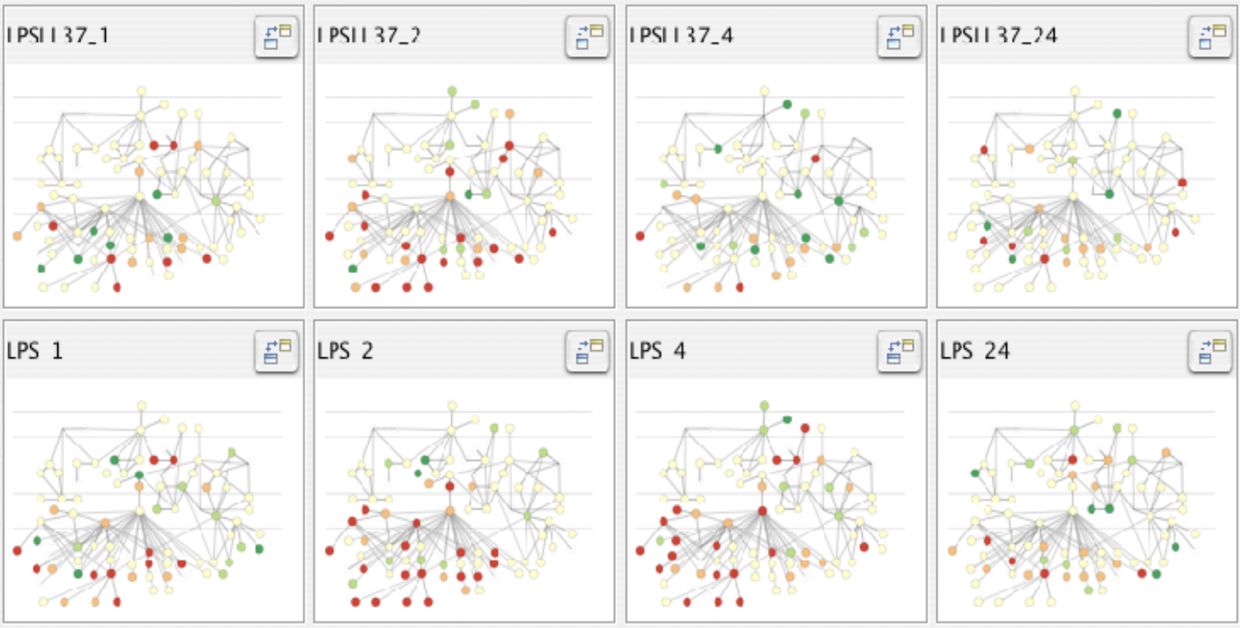
Representation for Data: Why?
Computer-based visualization systems provide visual representations of datasets designed to help people carry out tasks more effectively.
Replace cognition with perception

Slide 42
Why Depend on Vision?
Computer-based visualization systems provide visual representations of datasets designed to help people carry out tasks more effectively.
50% of our brain is dedicated to vision
Human visual system is high-bandwidth channel to brain
Vision is a MASSIVELY parallel processor dedicated to
Detect
Analyze
Recognize
Reason with

Slide 43
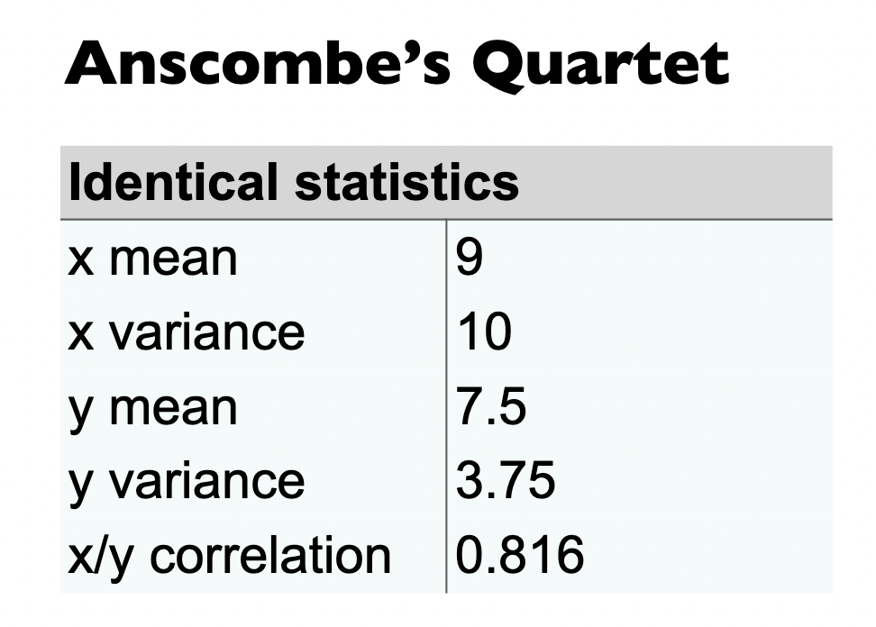
Why not Only Show the Summary Data?
Computer-based visualization systems provide visual representations of datasets designed to help people carry out tasks more effectively.
Summaries can lose information, details matter!
Confirm expected
Find unexpected patterns
Assess validity of data models

Slide 44
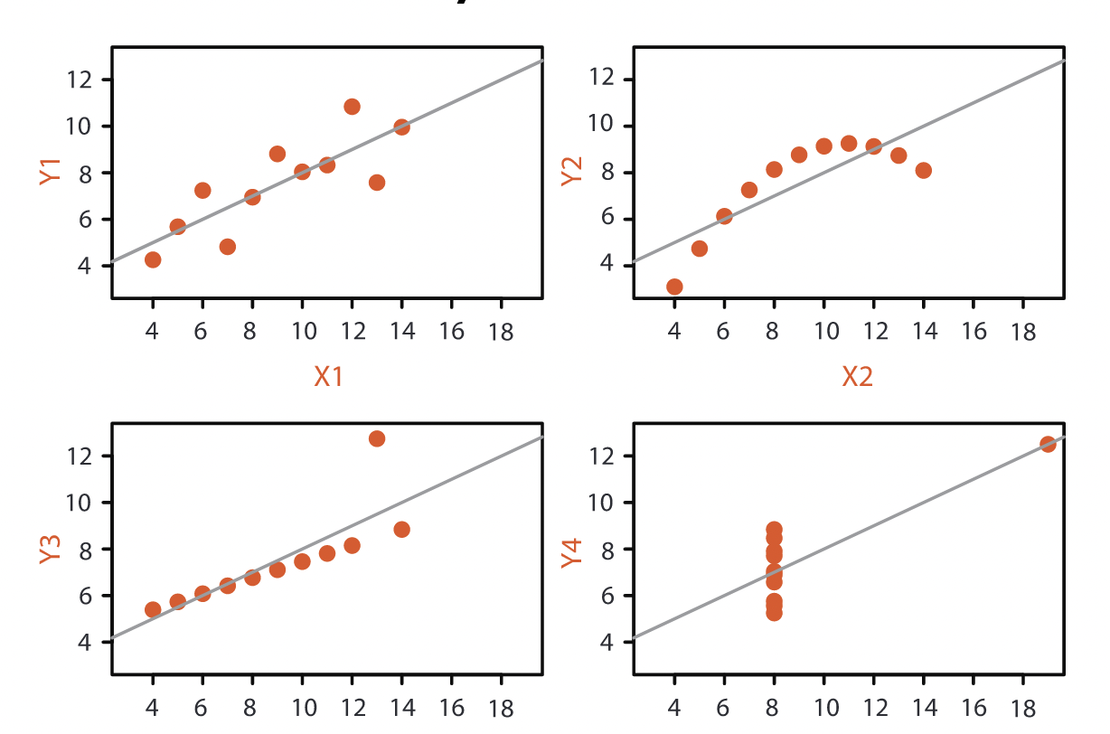
Why not Only Show the Summary Data?
Computer-based visualization systems provide visual representations of datasets designed to help people carry out tasks more effectively.

Slide 45
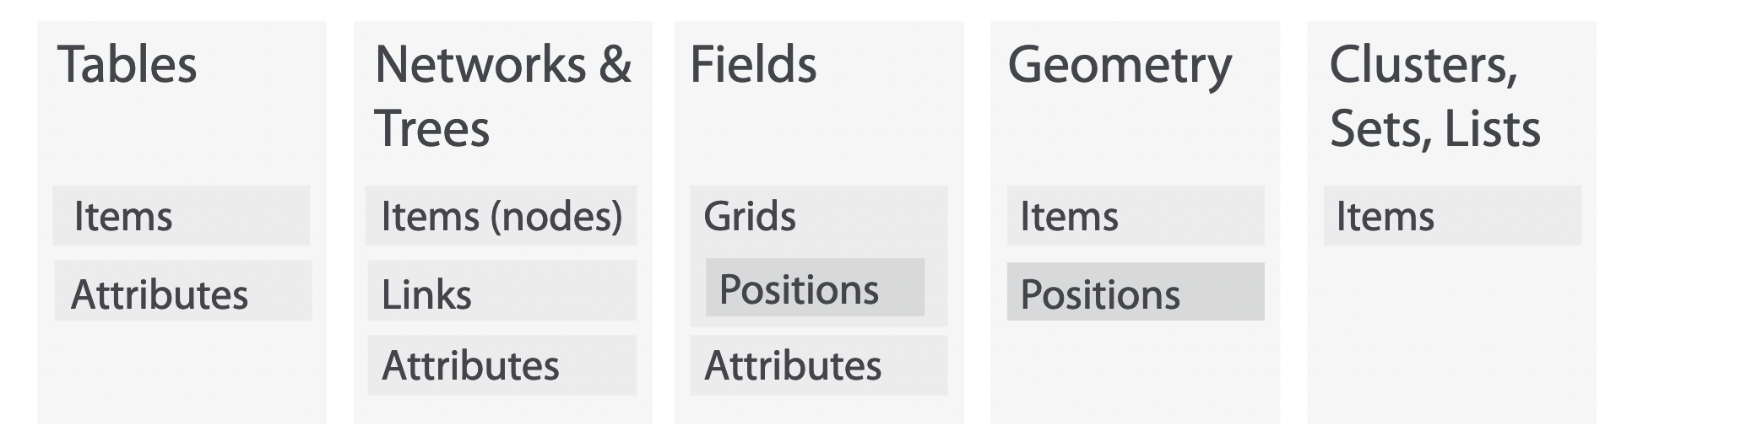
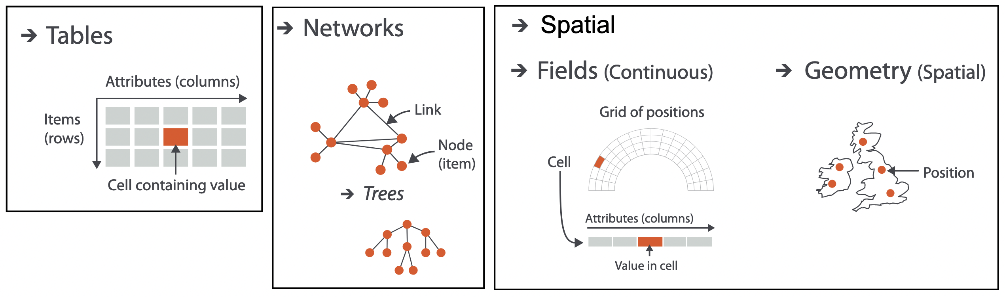
What About Datasets?

Slide 46
What All Are Needed With Visualization?
Data (wide variety)

Slide 47
What All Are Needed With Visualization?
Data (wide variety)
Algorithms
data mining
data analytics

Slide 48
What All Are Needed With Visualization?
Data (wide variety)
Algorithms
data mining
data analytics
Computer
run those algorithms
data storage

Slide 49
What All Are Needed With Visualization?
Data (wide variety)
Algorithms
data mining
data analytics
Computer
run those algorithms
data storage
Humans
with a purpose/need to understand their data
endowed with cognitive faculties, creative thought, intuition
domain expertise

Slide 50
What All Are Needed With Visualization?
Data (wide variety)
Algorithms
data mining
data analytics
Computer
run those algorithms
data storage
Humans
with a purpose/need to understand their data
endowed with cognitive faculties, creative thought, intuition
domain expertise
Understanding of humans
perception, cognition, HCI issues
we can gain it through experimentation with humans

Slide 51
Visual Analytics
Data (wide variety)
Algorithms
data mining
data analytics
Computer
run those algorithms
data storage
Humans
with a purpose/need to understand their data
endowed with cognitive faculties, creative thought, intuition
domain expertise
Understanding of humans
perception, cognition, HCI issues
we can gain it through experimentation with humans
= Visual Analytics

Slide 52
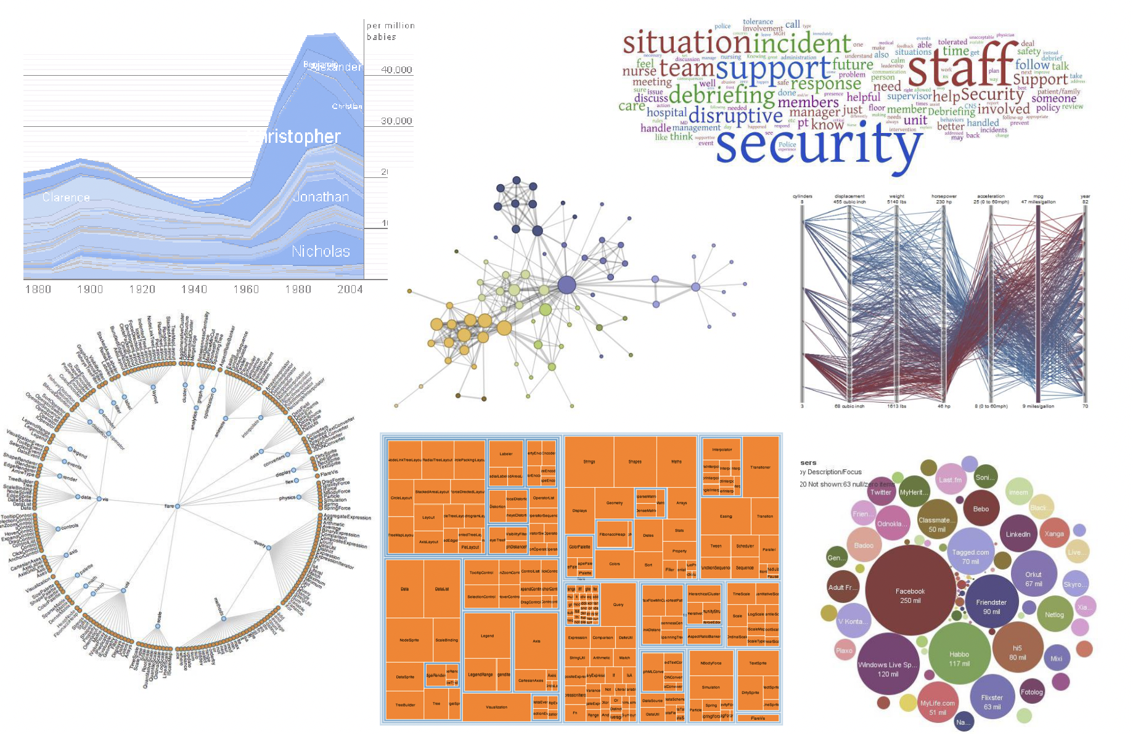
Visualization Can Be Beautiful

Slide 53

Visualization is Fast
< 200 ms to recognize the red dot

Slide 54
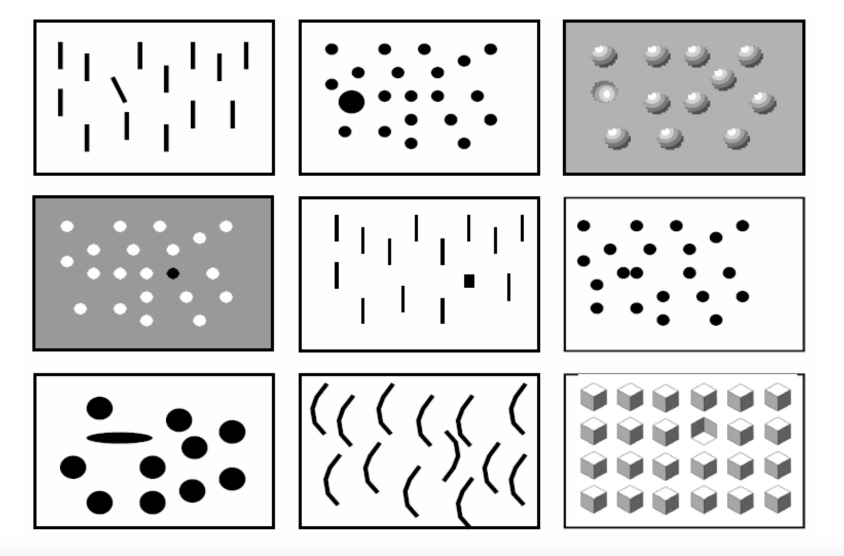
Visualization is Fast

Slide 55
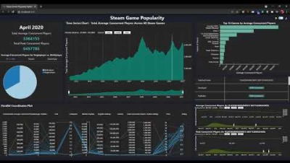
Visualization Can Be Interactive
https://www.youtube.com/watch?v=Aht3wotrrBk&list=PLyCRt3MN8s8OJp-M5UdCQv-NDllAqJOb5&index=5

Slide 56
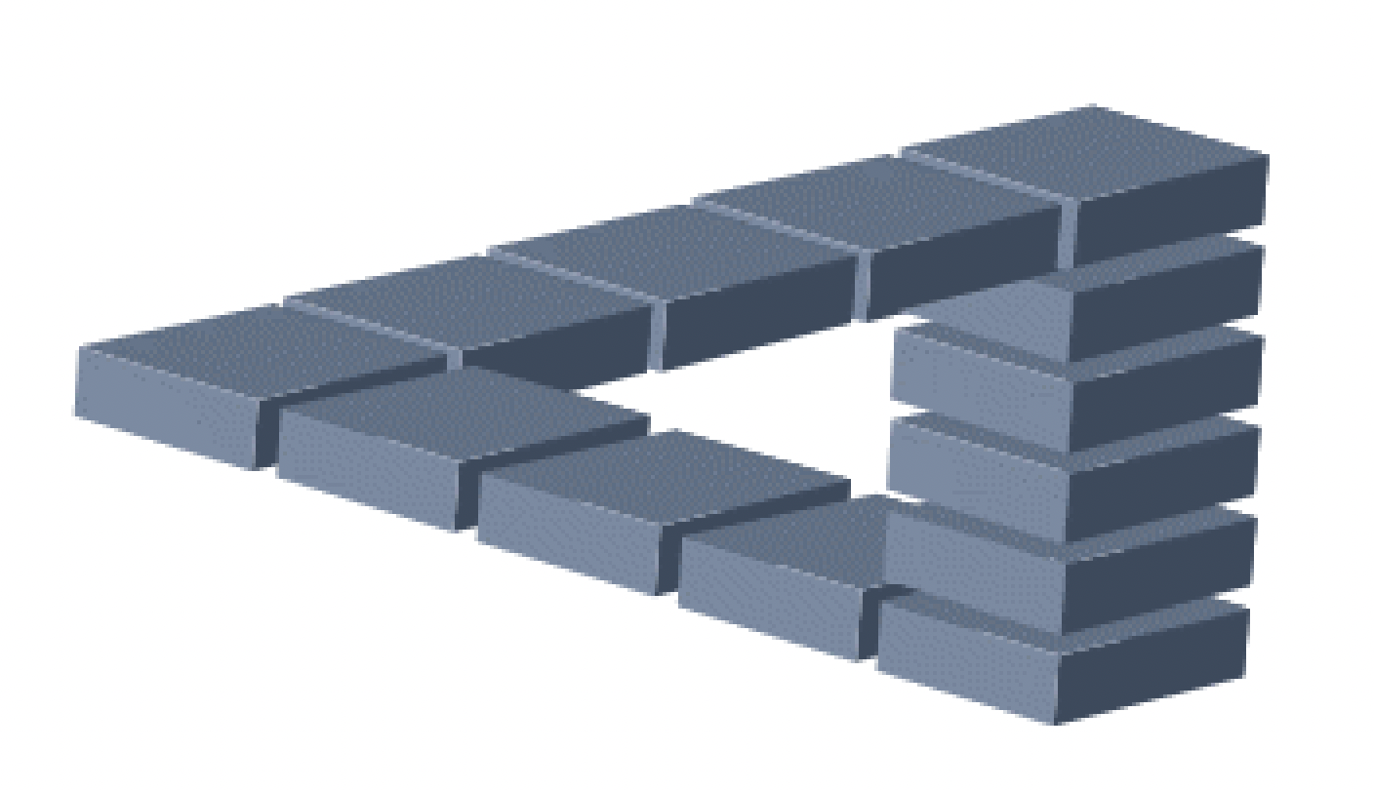
Visualization Can Be Deceptive

Slide 57

Visualization Can Be Deceptive
Which circle in the middle is larger?

Slide 58
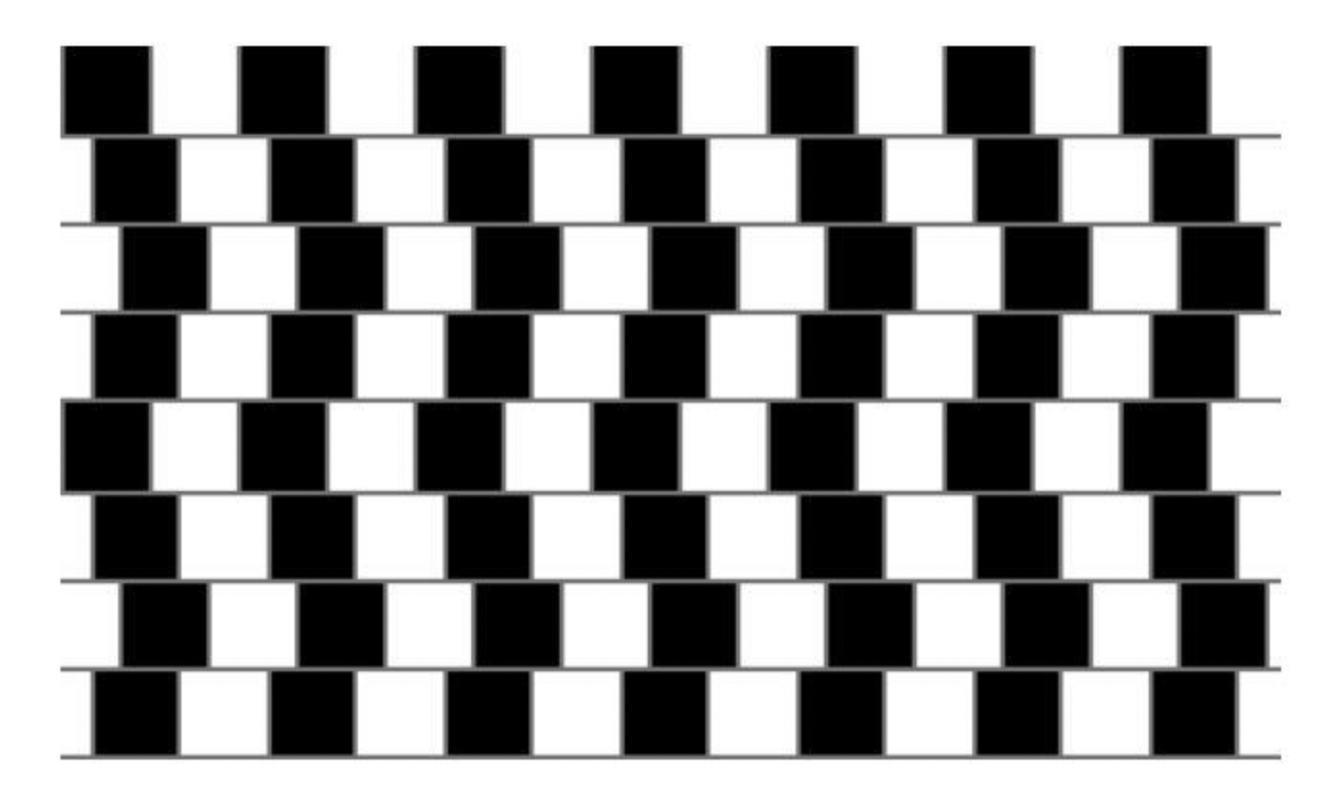
Visualization Can Be Deceptive
Are the horizontal lines parallel or do they slope?

